Slide 1

Basic BP ANNs
with
Daniel L. Silver, Ph.D.
Andy McIntyre, Ph.D.
June 18, 2019

Slide 2
Classification Systems and Inductive Learning
Vector Representation & Discriminate Functions
Linear Discriminate
Function
x
2
f(X)=f(x₁,x₂) =
w₀+w₁x₁+w₂x₂=0
or WX = 0
f(x₁,x₂) > 0 => A
f(x₁,x₂) < 0 => B
o
o
Height
A
o
o
o
*
B
*
*
*
*
Age
x
1

Slide 3
Classification Systems and Inductive Learning
f(X) = WX = 0 will discriminate class A from B,
But ... we do not know the appropriate values for :
w₀, w₁, w₂
Nature found a way to solve this problem …

Slide 4
From Biological to Artificial Neurons

Slide 5
From Biological to Artificial Neurons
The Neuron - A Biological Information Processor
dentrites - the receivers
soma - neuron cell body (sums input signals)
axon - the transmitter
synapse - point of transmission
neuron activates after a certain threshold is met
Learning occurs via electro-chemical changes in effectiveness of synaptic junction.

Slide 6
From Biological to Artificial Neurons

Slide 7
From Biological to Artificial Neurons
An Artificial Neuron - The Perceptron
Basic function of neuron is to sum inputs, and produce output given sum is greater than threshold
ANN node produces an output as follows:
1. Multiplies each component of the input pattern by the weight of its connection
2. Sums all weighted inputs and subtracts the threshold value => total weighted input
3. Transforms the total weighted input into the output using the activation function

Slide 8
Learning in a Simple Neuron
where f(a) is the
step function, such
that: f(a)=1, a > 0
f(a)=0, a <= 0
Logical OR
Function
x₁ x₂ y
0 0 0
0 1 1
0 1
1 1 1
w0=
w1
w2
x0=1
x1
x2

Slide 9
Learning in a Simple Neuron
where f(a) is the
step function, such
that: f(a)=1, a > 0
f(a)=0, a <= 0
“Full Meal Deal”
x1
x2
y
w0=
0 0 0
0 1 0
1 0 0
1 1 1
w1
w2
x0=1
x1
x2
Fries
Burger

Slide 10
Learning in a Simple Neuron
Perceptron Learning Algorithm:
1. Initialize weights
2. Present a pattern and target output
3. Compute output :
4. Update weights :
Repeat starting at 2 until acceptable level of error
This is an online method of computing a regression = fitting a function to a set of data points

Slide 11
Learning in a Simple Neuron
Widrow-Hoff or Delta Rule for Weight Modification
Where:
η = learning rate (o < η <= 1), typically set = 0.1
d = error signal = desired output - network output. = t – y
Fundamentally a gradient descent method of search
;

Slide 12
What is an artificial neuron doing when it learns?
Simple
Neural Network
1,0
1,1
Logical OR
Function
x₁ x₂ y
0 0 0
0 1 1
0 1
1 1 1
y = f(w₀+w₁x₁+w₂x₂)
x₂
0,0
0,1
x₁
The discriminate function divides up the 0 and 1 class examples.

Slide 13
Classification
1
Y
Logistic Regression
0
Y=f(M,T)
Y
B
B
B
B
B
B
B
B
B
B
M
T
B
A
B
A
B
B
Mistakes
B
B
B
A
B
A
B
B
A
A
B
A
B
A
A
B
B
B
B
A
A
A
A
A
A
B
A
A
B
A
A
B
A
Typing Speed

Slide 14
Limitations of Simple Neural Networks
The Limitations of Perceptrons
(Minsky and Papert, 1969)
Able to form only linear discriminate functions; i.e. classes which can be divided by a line or hyper-plane
Most functions are more complex; i.e. they are non-linear or not linearly separable
This crippled research in neural net theory for 15 years ....
Notes:
Show pattern space OH for “take-out special” vs. “Dinner for two”.
Also OHs for XOR and linear dependent points.

Slide 15
EXAMPLE
Simple
Neural Network
1,0
1,1
Logical XOR
Function
x1 x2 y
0 0 0
0 1 1
0 1
1 1 0
x₂
0,0
0,1
x₁
One linear discriminant function cannot divide up the 0 and 1 class examples.

Slide 16
TUTORIAL #1(a)
Develop and train a simple neural network to learn the OR and XOR function (perceptron.ipynb)
Notes:
OR_and_XOR.py

Slide 17
From Biological to Artificial Neural Networks
“Distributed processing
and representation”
o1
o2
Output Nodes
3-Layer Network
has
2 active layers
Hidden Nodes
Input Nodes
x1
x2
x3
x4

Slide 18
Multi-layer Feed-forward ANNs
Over the 15 years (1969-1984) research continued ...
hidden layer of nodes allowed combinations of linear functions
non-linear activation functions displayed properties closer to real neurons:
output varies continuously but not linearly
differentiable .... Sigmoid
non-linear ANN classifier was possible
But how are the weights learned …
Notes:
Show Multilayer neural network OH
Show XOR network OH.

Slide 19
Visualizing Network Behaviour
x1
Pattern Space
Weight Space
Visualizing the process of learning
function surface in weight space
error surface in weight space
x2
w0
w2
w1
Notes:
Show pattern space OH.
Show weight space OH with function and error surface.

Slide 20
The Back-propagation Algorithm
1986: the solution to multi-layer ANN weight update rediscovered
Conceptually simple - the global error is backward propagated to network nodes, weights are modified proportional to their contribution
Most important ANN learning algorithm
Become known as back-propagation because the error is send back through the network to correct all weights

Slide 21
The Back-propagation Algorithm
Like the Perceptron - calculation of error is based on difference between target and actual output:
However in BP it is the rate of change of the error with respect to each weight - the important feedback through the network generalized delta rule
Relies on a continuous non-linear activation function (sigmoid) for communication between layers
Notes:
Show BP of Network Error OH.
Show sigmoid activation function graph and values.

Slide 22
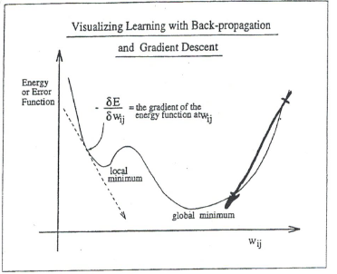
Visualizing BP as Gradient Descent
[Also see handout]

Slide 23
The Back-propagation Algorithm
Objective: compute for all
Definitions:
= weight from node i to node j
= totaled weighted input of node =
= output of node
= error for 1 pattern over all output nodes
Notes:
Show BP of Network Error which has the math on it.

Slide 24
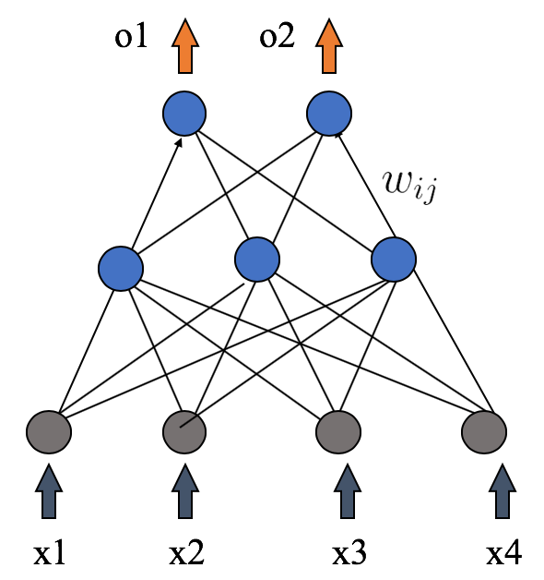
The Back-propagation Algorithm
Objective: compute for all
Four step process:
1. Compute how fast error changes as output of node j is changed
2. Compute how fast error changes as total input to node j is changed
3. Compute how fast error changes as weight coming into node j is changed
4. Compute how fast error changes as output of node i in previous layer is changed

Slide 25
The Back-propagation Algorithm
Where:
For output nodes:
For hidden nodes:

Slide 26
The Back-propagation Algorithm
On-Line algorithm:
1. Initialize weights
2. Present a pattern and target output
3. Compute output :
4. Update weights :
where
Repeat starting at 2 until acceptable level of error

Slide 27
The Back-propagation Algorithm
Visualizing the bp learning process:
The bp algorithm performs a gradient descent in weights space toward a minimum level of error using a fixed step size or learning rate
The gradient is given by :
= rate at which error changes as weights change
Notes:
Show Gradient descent and momentum term OH.

Slide 28
Weight Space
E
Error surface
w2
w1

Slide 29
The Back-propagation Algorithm
Momentum Descent:
Minimization can be speed-up if an additional term is added to the update equation:
where:
Thus:
Augments the effective learning rate to vary the amount a weight is updated
Analogous to momentum of a ball - maintains direction
Rolls through small local minima
Increases weight update when on stable gradient

Slide 30
EXAMPLE
Multi-layer
Neural Network
Hidden layer
of neurons
1,0
1,1
Logical XOR
Function
x1 x2 y
0 0 0
0 1 1
0 1
1 1 0
x₂
0,0
0,1
x₁
Two neurons are needed! Their combined results
can produce good classification.

Slide 31
Classification
Artificial Neural Network
Y
B
B
B
…
B
B
B
B
B
B
B
B
A
B
A
B
B
M
T
Mistakes
B
B
B
A
B
A
B
B
A
A
B
A
B
A
A
B
B
B
B
A
A
A
A
A
A
B
A
A
A
B
A
A
B
A
Typing Speed

Slide 32
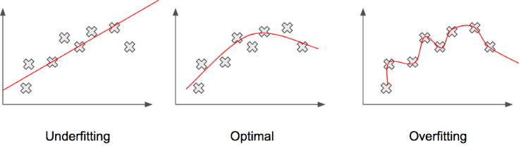
Generalization
The objective of learning is to achieve good generalization to new cases, otherwise just use a look-up table.
Generalization can be defined as a mathematical interpolation or regression over a set of training points

Slide 33
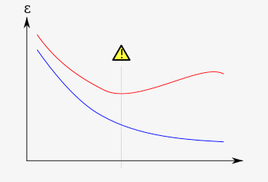
Generalization
Preventing Over-training:
Use a separate validation or tuning set of examples
Monitor error on the val. set as network trains
Stop training just prior to over-fit error occurring = early stopping or tuning
Number of effective weights is reduced
Most new systems have automated early stopping methods
Best model
Error on Validation Set
Error on Training Set
Number of Iterations

Slide 34
Generalization
Weight Decay: an automated method of effective weight control
Adjust the bp error function to penalize the growth of unnecessary weights:
where: = weight -cost parameter λ
is decayed by an amount proportional to its magnitude; those not reinforced => 0

Slide 35
TUTORIAL #1(b)
Develop and train a backpropagation network to learn XOR function (mlp_bp_ann.ipynb)
Notes:
OR_and_XOR.py

